Slide 1

Pension Management System
Done By :
Priyanshu Prakash

Slide 2
Introduction
The main objective of the pension management system is to manage the pension activity.
Admin can login and check the applicant status and update status and applicants can check their application.
The pension management system which helps to manage the activity of pensions like applicants, applicant's details, balance, manage applications and manage the record of pensions issued.
The use of this project is to reduce the manual work, document management work in pension offices to increase security and save time.

Slide 3
Tools Requirement
Intellij
Docker
PostMan
Spring-boot
Apache Maven
Mysql Db

Slide 4
Annotations
@GetMapping: It maps the HTTP GET requests on the specific handler method.
@PostMapping: It maps the HTTP POST requests on the specific handler method.
@PutMapping: It maps the HTTP PUT requests on the specific handler method
@DeleteMapping: It maps the HTTP DELETE requests on the specific handler method
@RequestBody: It is used to bind HTTP request with an object in a method parameter. Internally it uses HTTP Message Converters to convert the body of the request
@ResponseBody: It binds the method return value to the response body. It tells the Spring Boot Framework to serialize a return an object into JSON and XML format.
@PathVariable: It is used to extract the values from the URI. It is most suitable for the RESTful web service, where the URL contains a path variable. We can define multiple @PathVariable in a method.
@RequestParam: It is used to extract the query parameters form the URL. It is also known as a query parameter.

Slide 5
ADMIN Roles
Create Pension
Edit Applicant
Verify Status
Issue Pension
Load Balance
Approve Applicant

Slide 6
USER Role
Check Employee Status
Check Pension Approval
Check Application Status
Check Balance

Slide 7
PostMan Request
POST
localhost:8082/createPension
GET
localhost:8082/checkApplication/{id}
GET
localhost:8082/checkStatus/{id}
GET
localhost:8082/checkBalance/{id}
GET
localhost:8082/issuePension
PUT
localhost:8082/loadPension

Slide 8
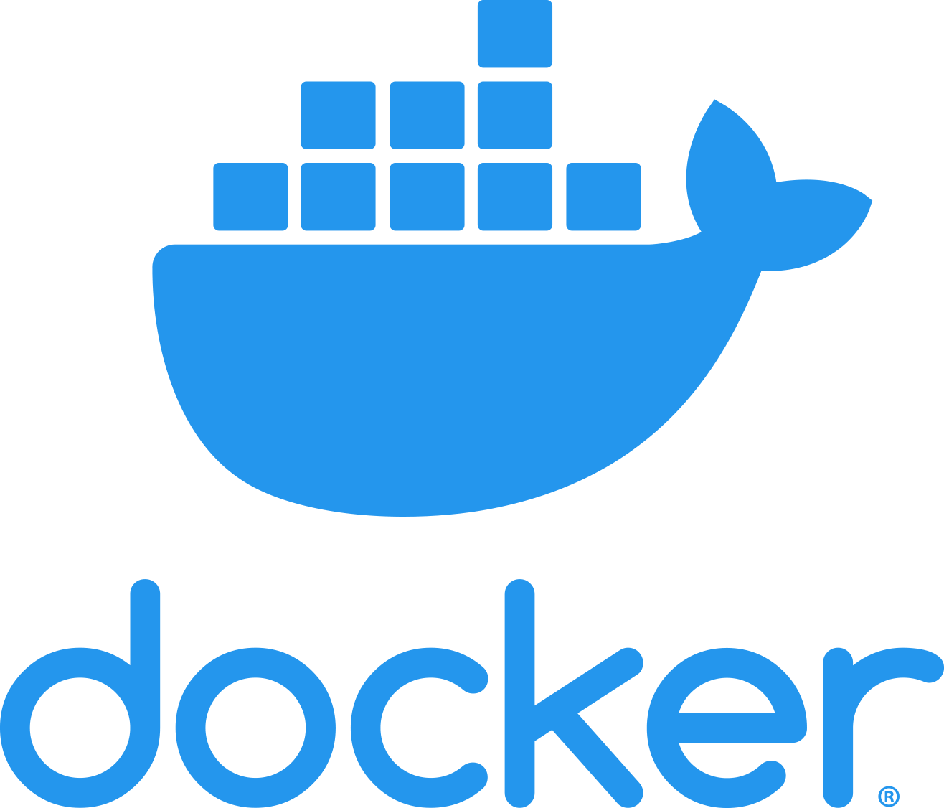
DOCKER
Docker is an open platform for developing, shipping, and running applications. Docker enables you to separate your applications from your infrastructure so you can deliver software quickly. With Docker, you can manage your infrastructure in the same ways you manage your applications. By taking advantage of Docker’s methodologies for shipping, testing, and deploying code quickly, you can significantly reduce the delay between writing code and running it in production

Slide 9
Steps of Dockerization
1. To dockerization we need Dockerfile in our application.
2.After that start docker from docker desktop
3.Run command mvn install dockerfile:build
4.Check docker desktop weather image is created or not
5.Push to docker hub from docker desktop.

Slide 10
Application
Reduce the manual work.
Easy to understand.
Reduce the document management work.
It will save time.

Slide 11
Conclusion
This project focuses on developing and implementing a web-based pension fund management information system that automates the pensioners’ registration process, an integrated platform for selecting preferred PFA will enable storage, manipulation, retrieval, retention and viewing of records, documents of employee/pensioner’s information.

Slide 12
THANK YOU

